Slide 1

TASK-2
Name : Appini Akhil E-mail: appiniakhil01@gmail.com Contact no.: 7569891286

Slide 2

The ScreenShots of the Netsparker analysis are added in the upcoming slides

Slide 3
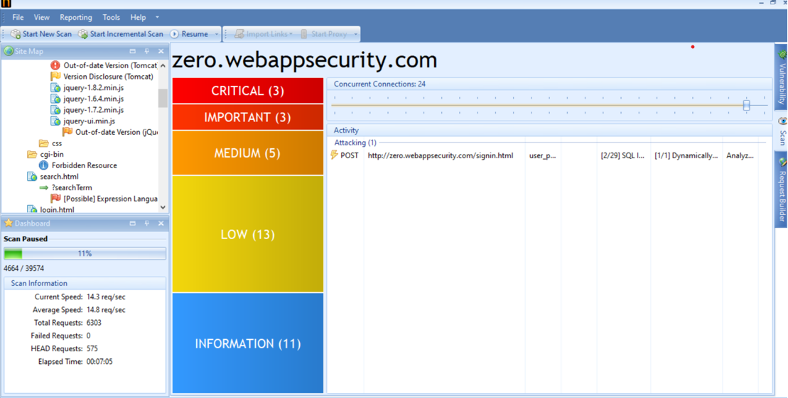

Slide 4
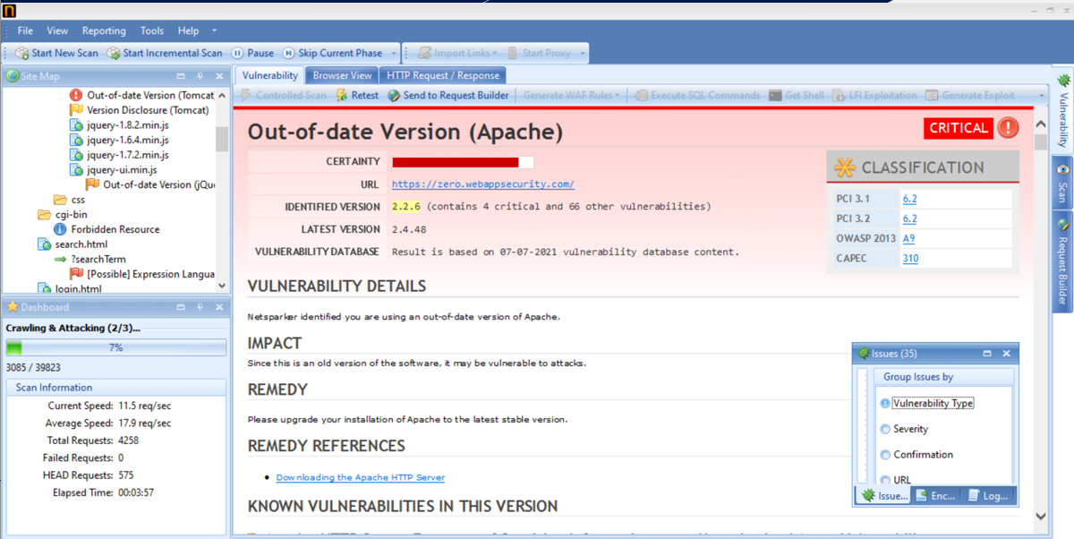

Slide 5
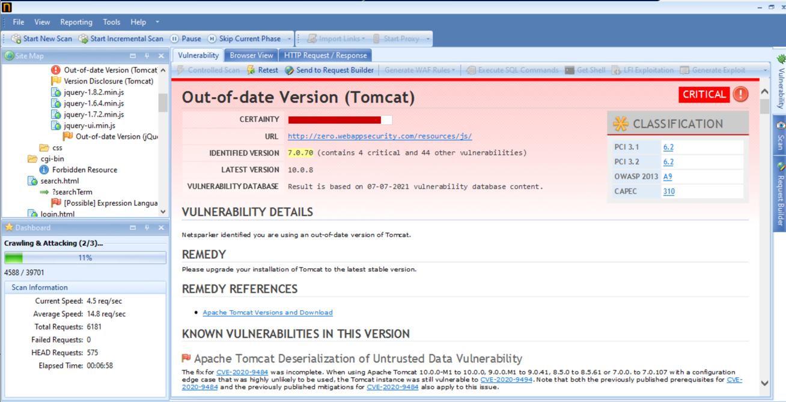

Slide 6
REPORT:
Title :- Out-Of-Date Version(Apache)
Domain :- https://zero.webappsecurity.com/
Vulnerability Details :- we are using out of date version of apache.
Severity :- High
Impact :- 1) we are using an old version, so it may be vulnerable to attacks.
2) so if we use the older version it will be more vulnerable to random attacks, malware and data breaches.
3) it can be backdoor for hackers to enter into our device.
4) it allow remote attackers to get sensitive information through a crafted request that triggers access to memory locations associated with an earlier request.
Remedy :- Please update to latest version and secure your website

Slide 7
Thank You

